Slide 1
Lecture 22-23
Relational Database Design

Slide 2
Outline
Data Redundancy and Update Anomalies
Insertion Anomalies
Deletion Anomalies
Modification Anomalies
Functional Dependencies
Characteristics of Functional Dependencies
Identifying Functional Dependencies
Identifying the Primary Key for a Relation
Using Functional Dependencies

Slide 3
Overview
Combined Schema → redundant data
Problems -Data Anomalies
Insertion
Deletion
Updation (modification)
Solution: Decomposition
Should be lossless and dependency preservation
Using Functional Dependencies
Partial
Full
Transitive
Using FD Closure
Normalization

Slide 4
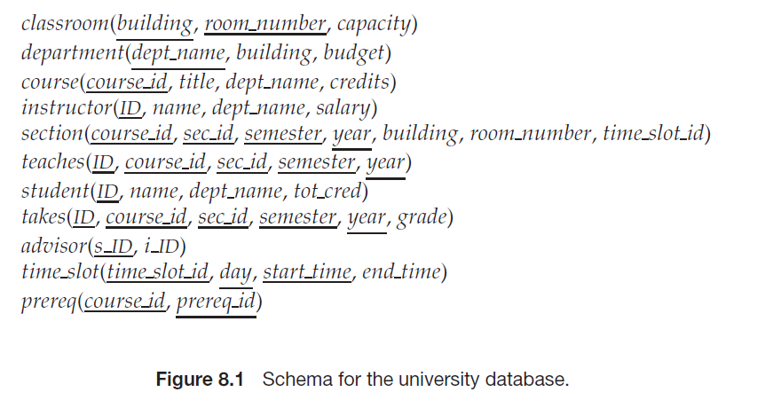
University Schema

Slide 5
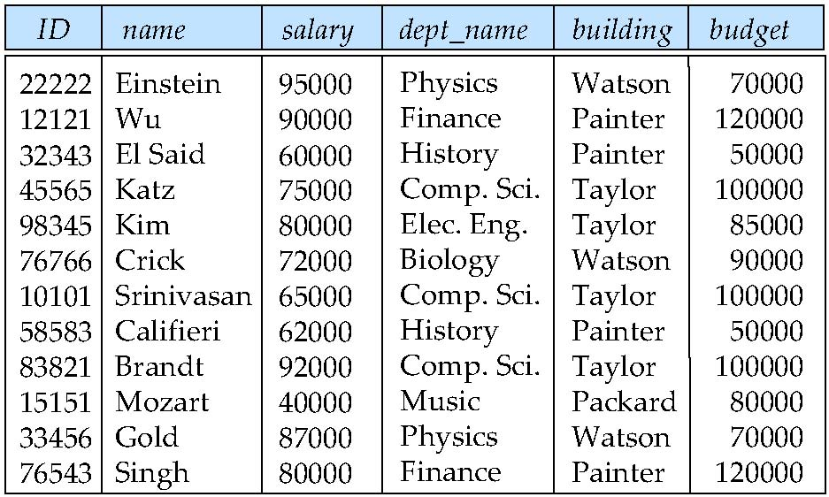
Design Alternative: Larger Schemas

Slide 6
Data Redundancy and Update Anomalies
Relations that contain redundant information may potentially suffer from update anomalies.
Types of update anomalies include:
Insertion
Deletion
Modification
© Pearson Education Limited 1995, 2005

Slide 7












Redundancy Misconception
Repeating a value is not redundant
FriendName
HairColor
Jack
Red
Duplicates?
Jane
Red
FriendName
HairColorID
HairColorID
Color
Jack
3
1
Black
Jane
3
2
Blond
e
3
Red
4
Brown
Jack has red hair.
Jane has red hair.
No duplicates!

Slide 8
Design Alternative: Smaller Schemas
Suppose again that, somehow, we had started out with the schema inst_dept. How would we recognize that it requires repetition of information and should be split (decompose) into the two schemas instructor and department?
Write a rule “if there were a schema (dept_name, building, budget), then dept_name would be a candidate key”
Denote as a functional dependency:
dept_name → building, budget
In inst_dept, because dept_name is not a candidate key, the building and budget of a department may have to be repeated.
This indicates the need to decompose inst_dept

Slide 9
Decomposition
The only way to avoid the repetition-of-information problem in the in_dep schema is to decompose it into two schemas – instructor and department schemas.
Not all decompositions are good. Suppose we decompose
employee(ID, name, street, city, salary)
into
employee1 (ID, name)
employee2 (name, street, city, salary)
The problem arises when we have two employees with the same name
The next slide shows how we lose information -- we cannot reconstruct the original employee relation -- and so, this is a lossy decomposition.

Slide 10
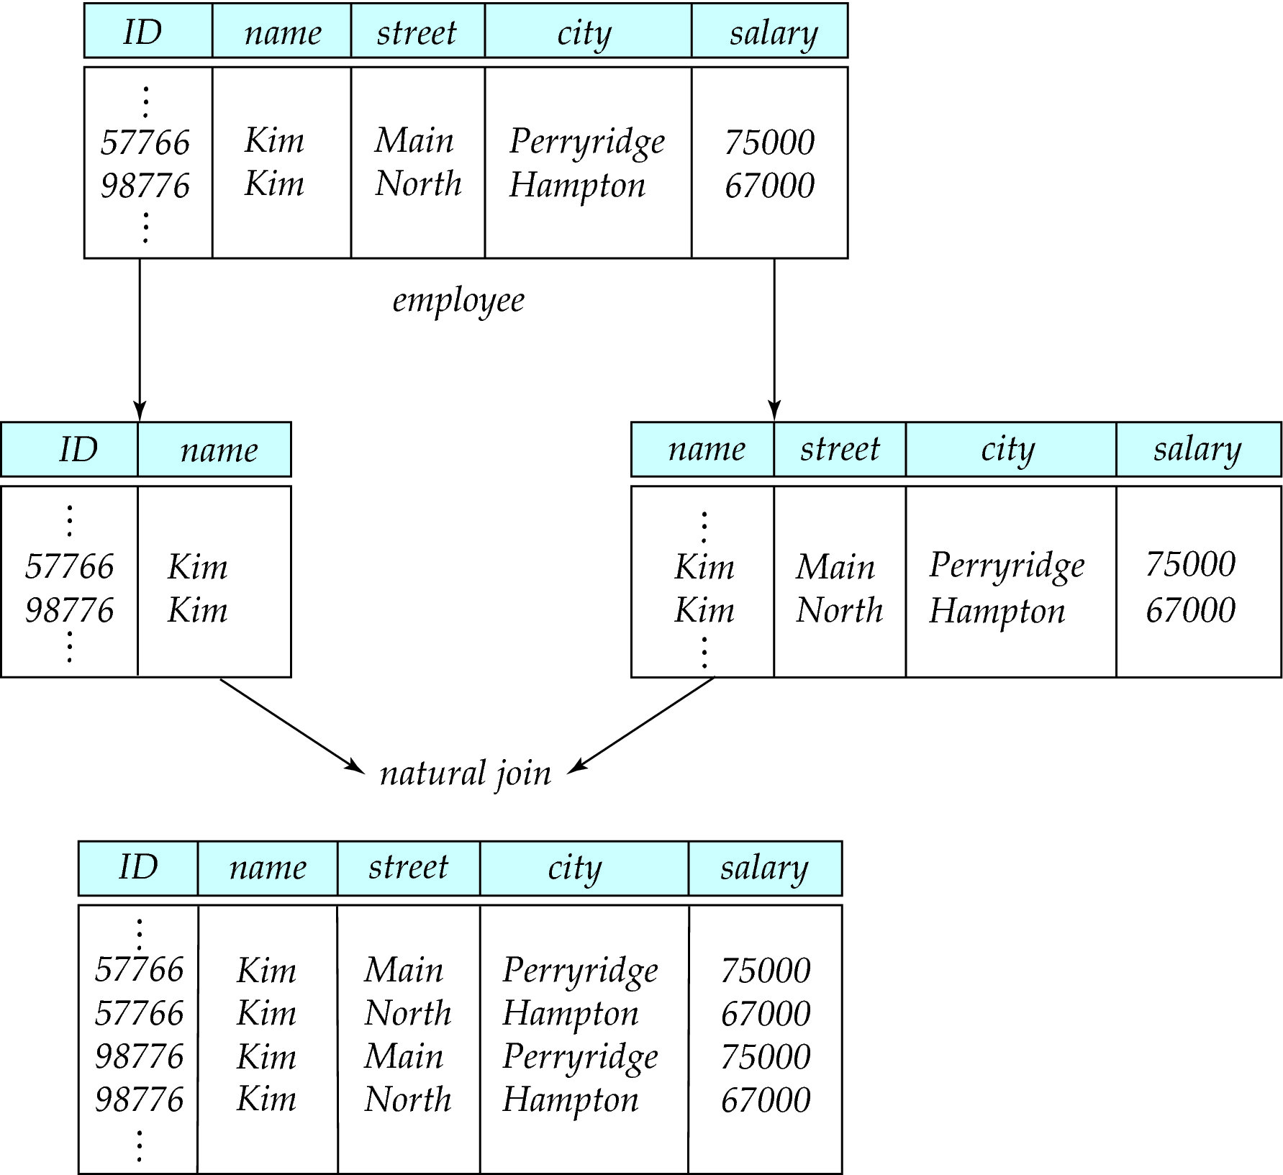
A Lossy Decomposition

Slide 11
Lossless Decomposition
Let R be a relation schema and let R₁ and R₂ form a decomposition of R . That is R = R₁ U R₂
We say that the decomposition is a lossless decomposition if there is no loss of information by replacing R with the two relation schemas R₁ U R₂
Formally,
∏ _{R1} (r) ∏ _{R2} (r) = r
And, conversely a decomposition is lossy if
r ⊂ ∏ _{R1} (r) ∏ _{R2} (r) = r

Slide 12
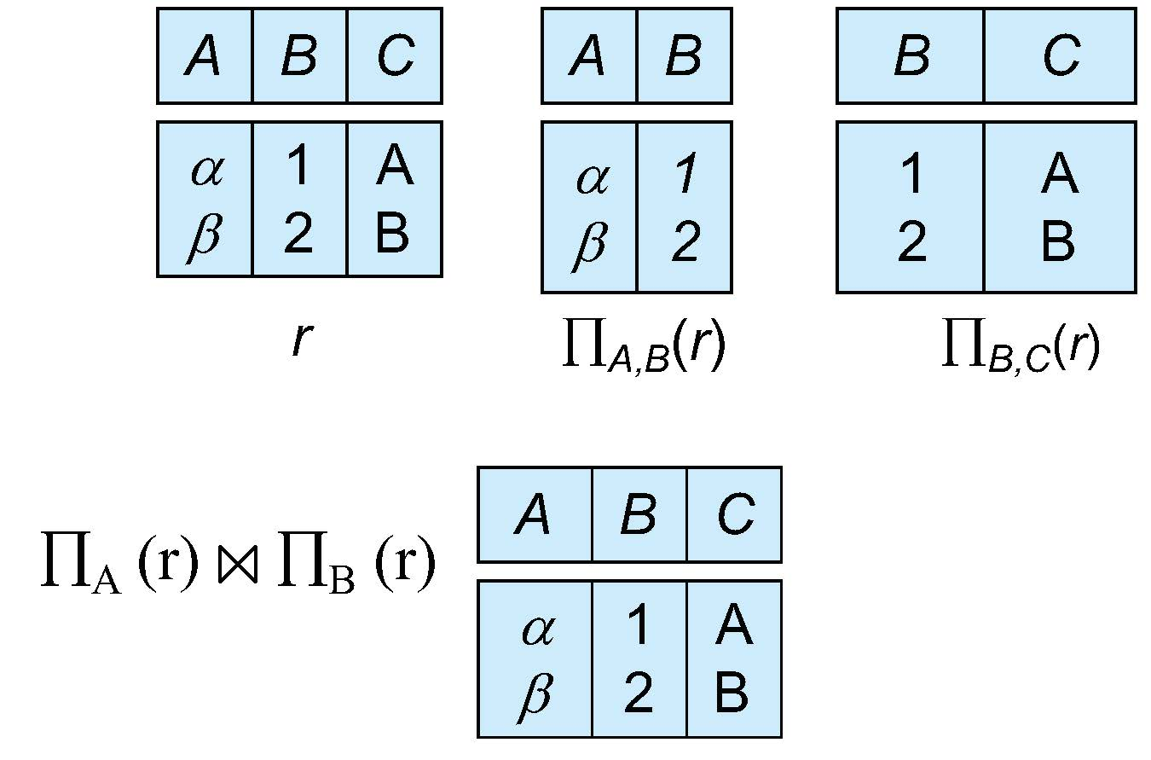
Example of Lossless Decomposition
Decomposition of R = (A, B, C) R₁ = (A, B) R₂ = (B, C)

Slide 13
Functional Dependencies
There are usually a variety of constraints (rules) on the data in the real world.
For example, some of the constraints that are expected to hold in a university database are:
Students and instructors are uniquely identified by their ID.
Each student and instructor has only one name.
Each instructor and student is (primarily) associated with only one department.
Each department has only one value for its budget, and only one associated building.

Slide 14

Characteristics of Functional Dependencies
Functional dependency describes relationship between attributes.
For example, if A and B are attributes of relation R, B is functionally dependent on A (denoted A → B), if each value of A in R is associated with exactly one value of B in R.
Diagrammatic representation.
The determinant of a functional dependency refers to the attribute or group of attributes on the left-hand side of the arrow.
© Pearson Education Limited 1995, 2005

Slide 15
Suggested Reading
Chapter 14 of Database Systems: A Practical Approach to Design, Implementation, and Management by Thomas Conolly 6th Edition
Chapter 8 of Database System Concepts by Abraham Silberschatz

Slide 16
References
https://www.db-book.com/db6/slide-dir/index.html
https://www.pearson.com/us/higher-education/product/Connolly-Powerpoint-Slides-for-Database-Systems

